Slide 1
Lib Indexer
Indexing books with unique labels in library shelves
Anna Berezhinskaya, Anand Eichner, Laurenz Fiala, Aleksandar Vucenovic, Jansen Wu

Slide 2
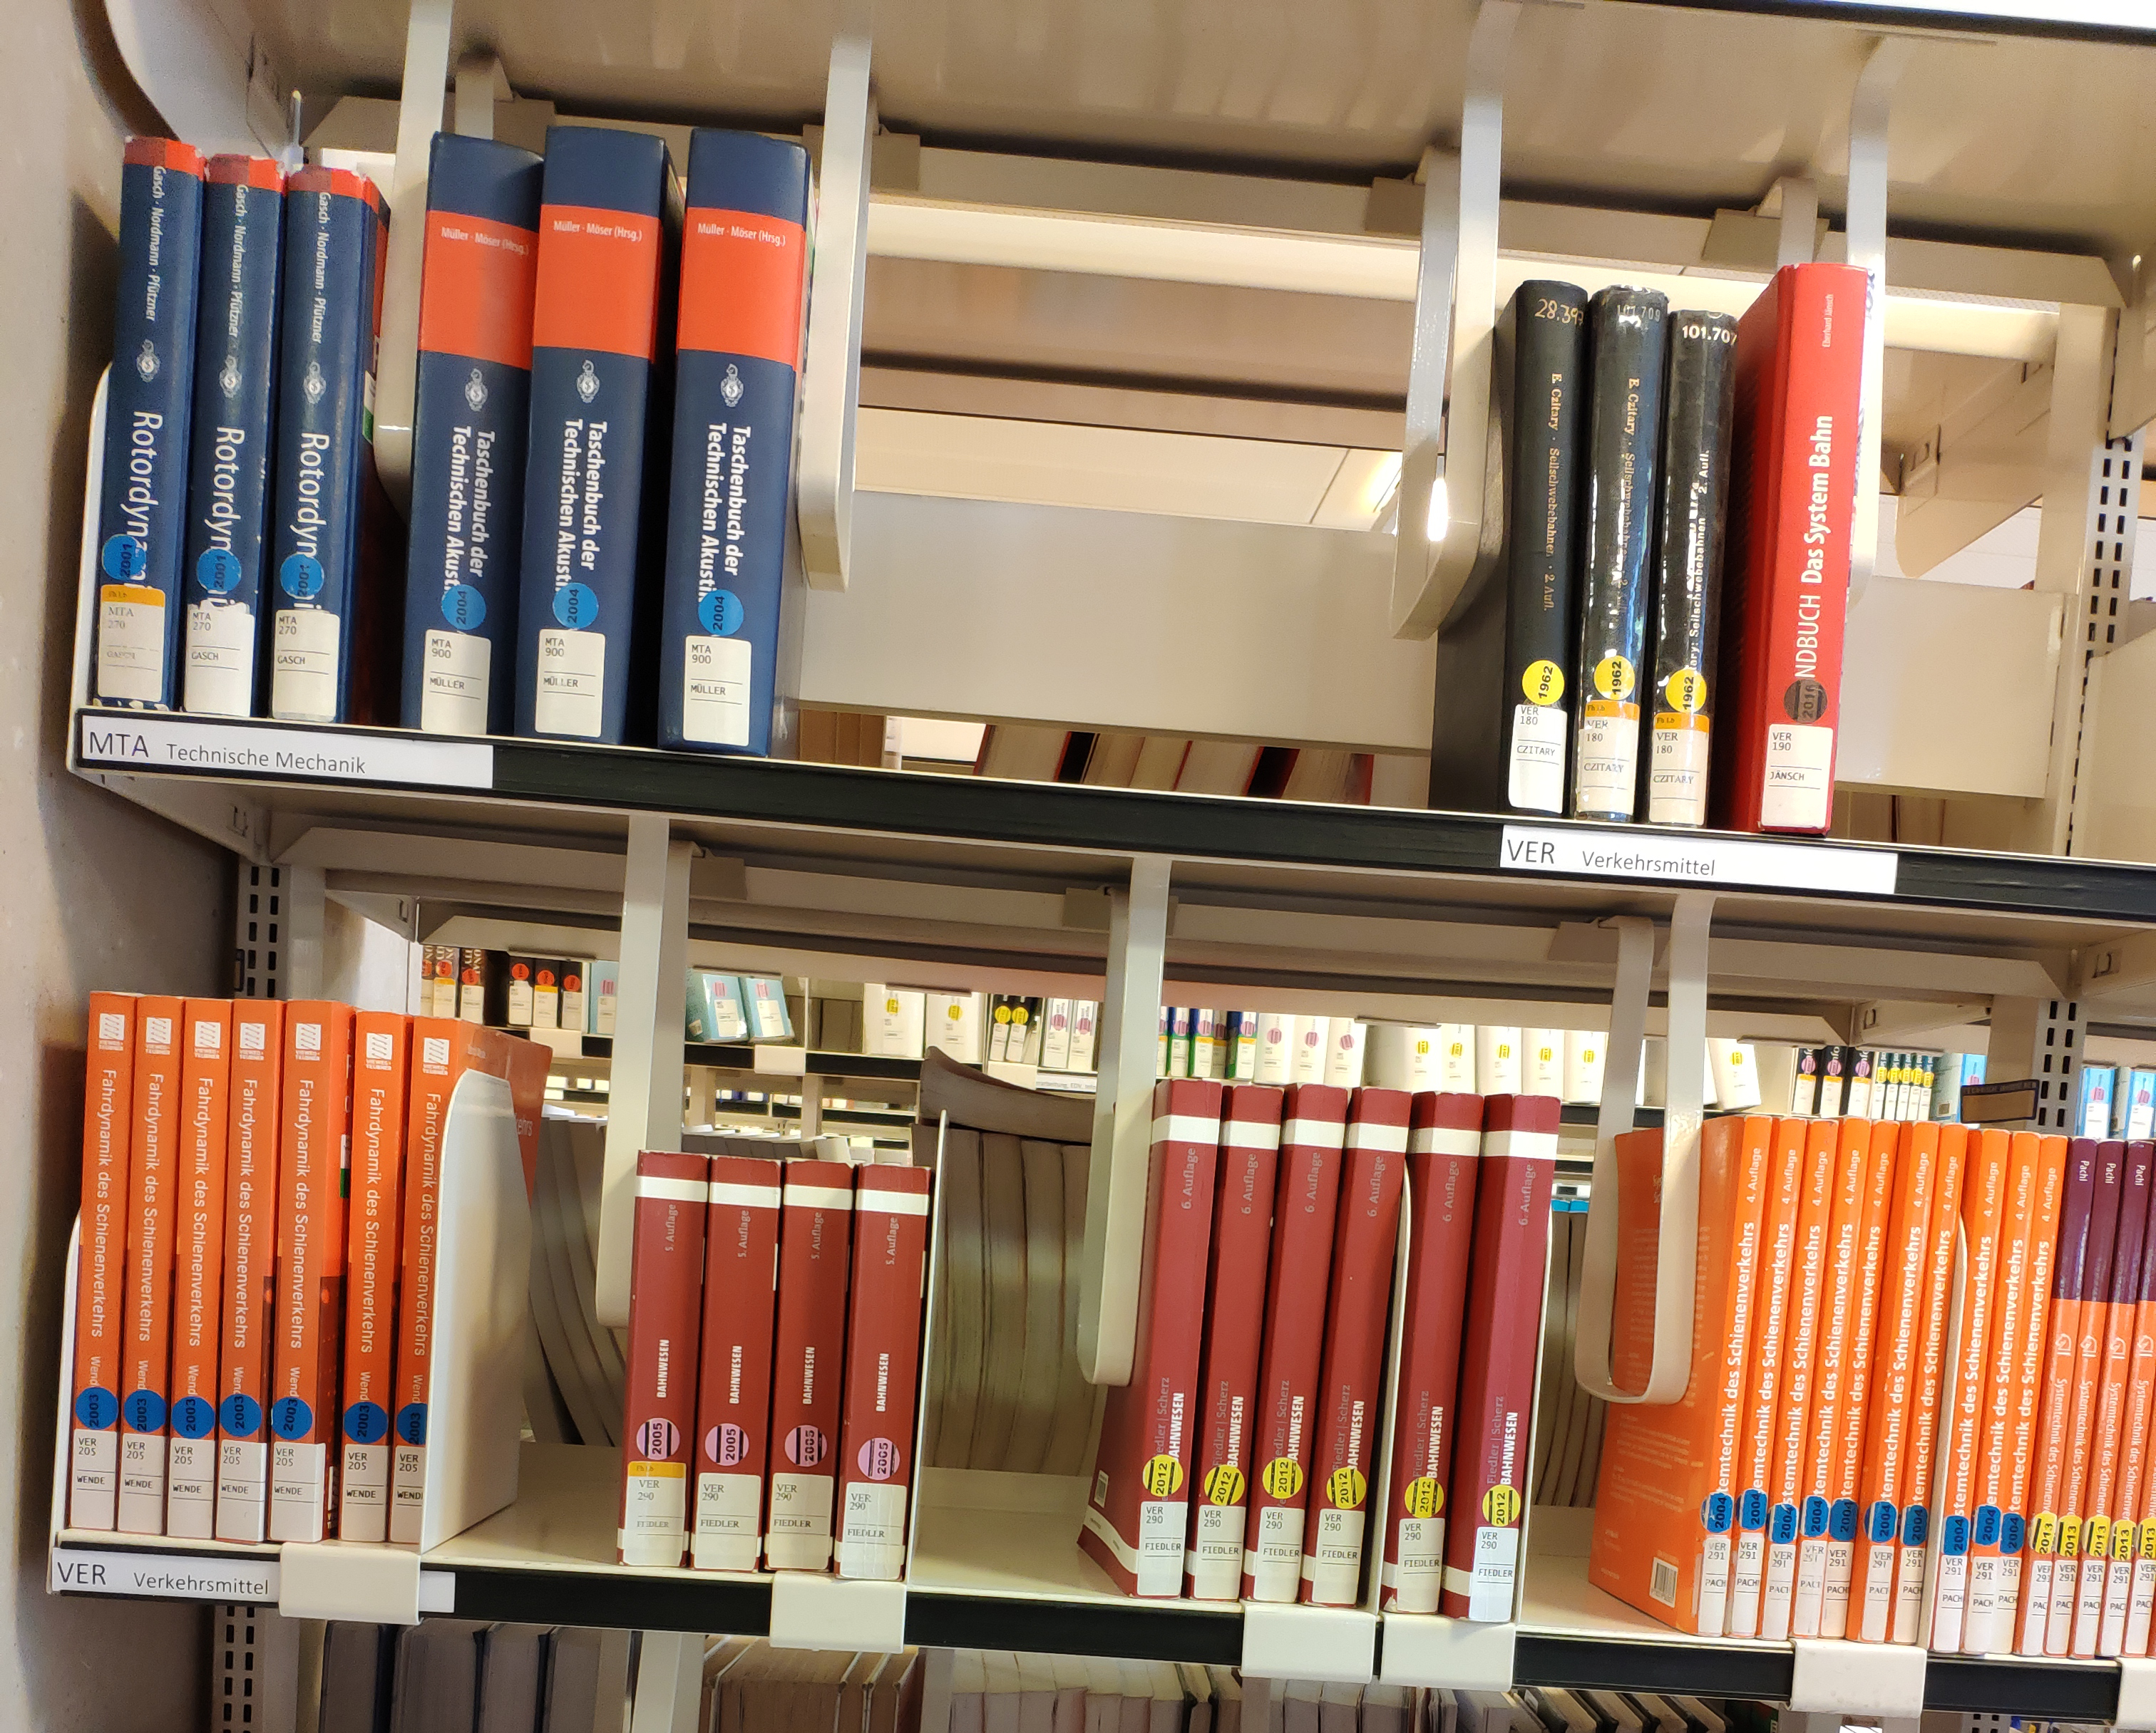
Input
Image of bookshelf
Books may not be tilted
Have a unique TU-bib label
Image must be sharp
Image must have readable labels

Slide 3
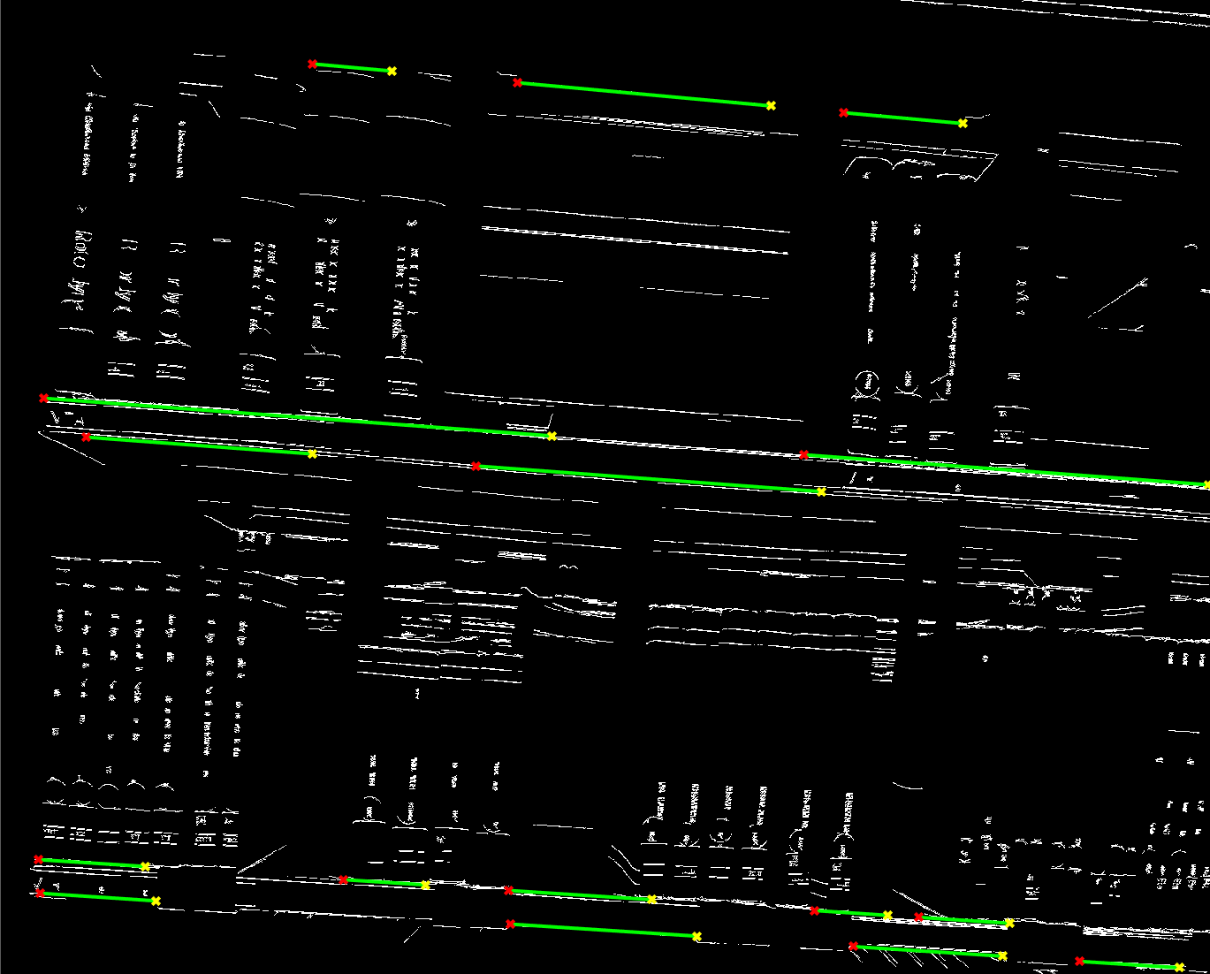
Detect Shelves
Find shelves with Hough Transform
Shelf boards may not be tilted by more than 30°
Perspective correction
TBD: Relative size of a single shelf for label detection

Slide 4
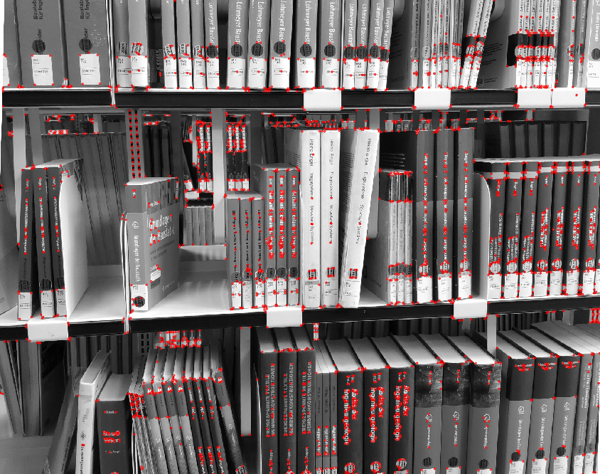
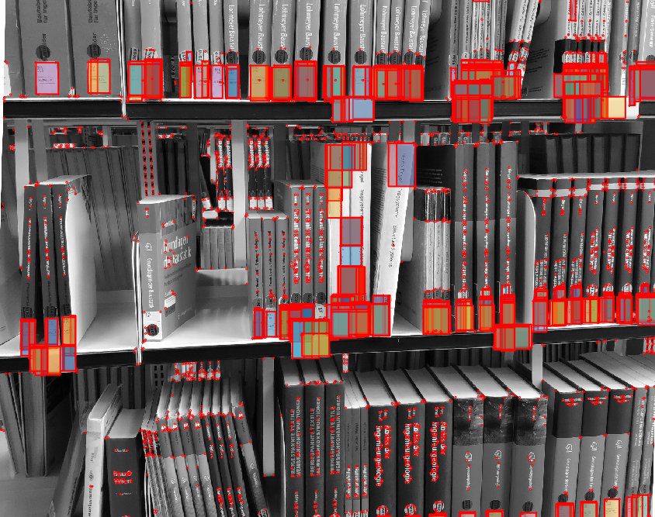
Label detection
TBD: Harris corner detector
Integral imaging for labels (brightness / darkness ratio)
Min/max-label size
TBI: Heuristics to eliminate duplicates

Slide 5
Label-coordinates
Put all label candidates into a custom coordinate system

Slide 6
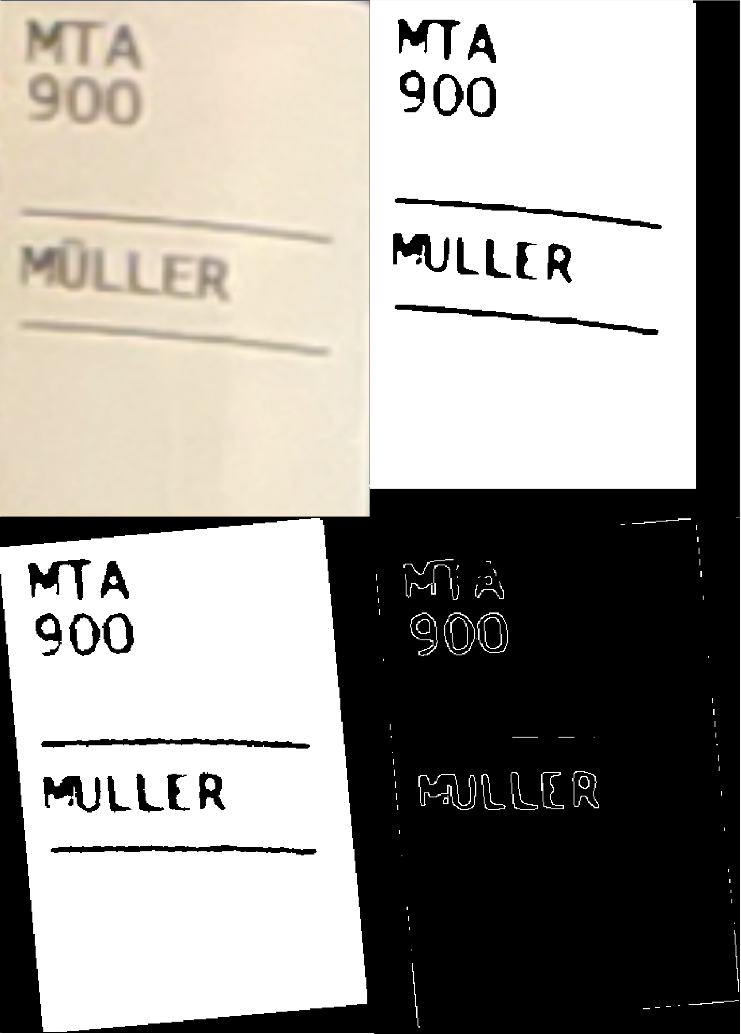
Optical Character Recognition
Preprocessing
Noise removal
Upscale label
Straighten image
Remove lines
Template matching
26 uppercase letters
10 digits

Slide 7
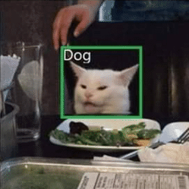
Thanks for listening

